Slide 1

Auto Tune ML
By- Divya Rao (dirao)
Prakriti Singh (praksing)
Rohan Bhoi (robhoi)
Sreeja Deb (srde)
Sudhansu Taparia (sutapari)

Slide 2
Auto Tune ML Framework
Problem Statement
Data Scientists spend lot of energy in preprocessing the data and getting the right sample. Non-Data Scientists struggle with the intrinsic nature of extensive ML. We need a solution which can automate and accelerate the ML process while keeping it simple and ensuring the 'Fairness' of the ML process.
Objective
The Auto Tune ML leverages the Azure Automated ML coupled with components like Data Sampler, Data Cleanser etc. that ensures quality data that are critical pre-steps to modelling, thus providing the users with a simplistic solution to productionize any ML model.

Slide 3
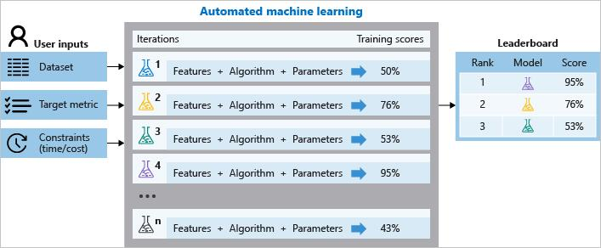
Azure Auto ML
What is Azure Auto ML?
Azure Automated Machine Learning tools (Auto ML), promise to reduce the time and effort needed to develop an effective machine learning model by automating the time consuming, iterative tasks of machine learning model development. At its simplest , Auto ML capabilities promise to take a data set, and (with a relatively small amount of input from the user), then automatically try many different possible combination of ML models, data features and configuration parameters, scoring the output of the model for each approach tried, and then reporting back the approach that scored highest.

Slide 4
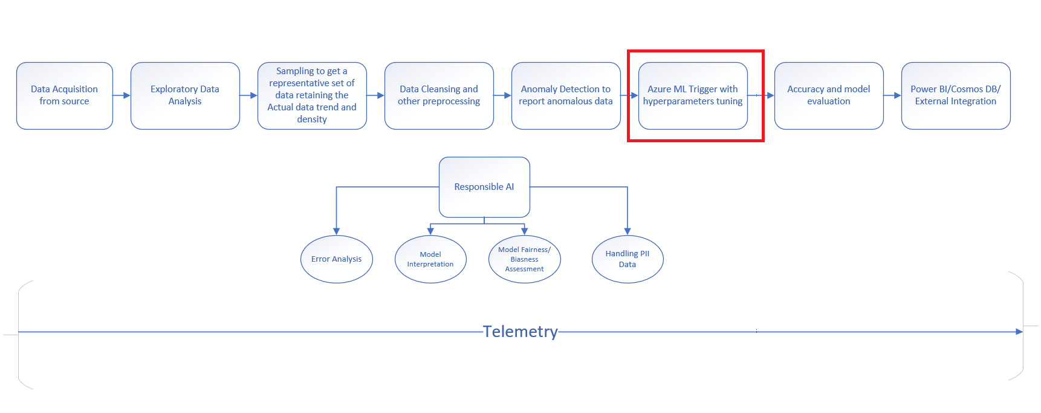
Auto Tune ML Process Flow
* Azure ML Trigger is out of the box Microsoft Azure Auto ML offering

Slide 5




Auto Tune ML Features (Fully automated)
Sampling
Sampling ensures convenience, collection of intensive and exhaustive data, suitability in limited resources and better rapport.
Cleansing
Improves your data quality and in doing so, increases overall productivity
Exploration
Exploratory Data Analysis & Visualization helps understand data better.
Automatically detects and suggets the anomalies for your data
Accuracy
Improves accuracy of the overall process
Time
Reduces the overall experimentation time
Responsible AI
Responsibly handle data sensitivity and security
Anomaly Detection
Telemetry
Captures all steps of processing to do a comparative analysis of models

Slide 6
Prerequisites
Azure Auto ML Workspace
Databricks cluster with Python notebook enabled
Azure Data Lake Storage
Getting Started
Import Databricks Notebooks- AutoTuneML_Master & AutoTuneML_Trigger
Follow the steps in each cell of AutoTuneML_Trigger Notebook

Slide 7
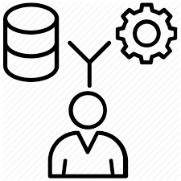
Data Acquisition
Acquiring and creating the first hand Dataset using both Technical and Business Domain expertise to be used in the ML Pipeline.

Slide 8
Acquire Data & Datatype Conversion
Function Call
Output
DataTypeConversion(input_dataframe,cols_string,cols_int,cols_datetime,cols_Float)
Will return a pandas dataframe with Datatype Conversion as desired.

Slide 9

Exploratory Data Analysis Exploratory Data Analysis refers to the critical process of performing initial investigations on data to discover patterns, to spot anomalies, to test hypothesis and to check assumptions with the help of summary statistics and graphical representations.

Slide 10
Exploratory Data Analysis
Function Call
Data_Profiling (input_dataframe)
Visualize
Visualize the EDA results

Slide 11
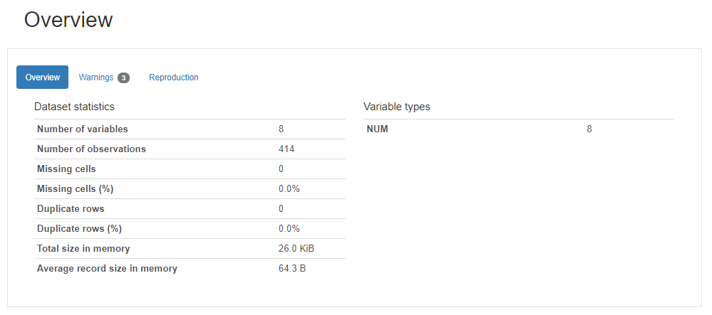
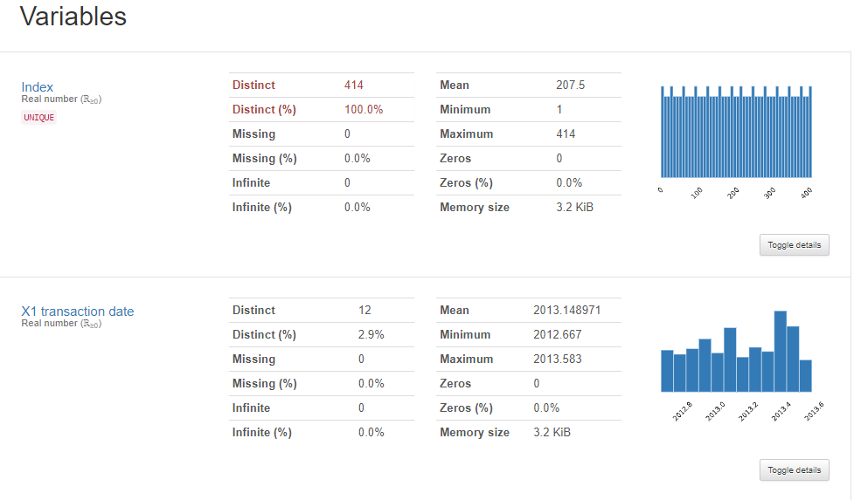
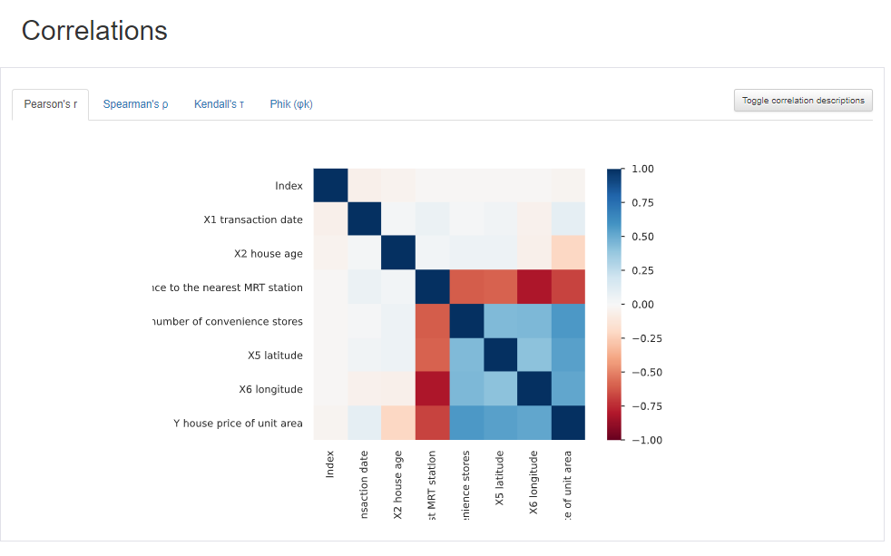
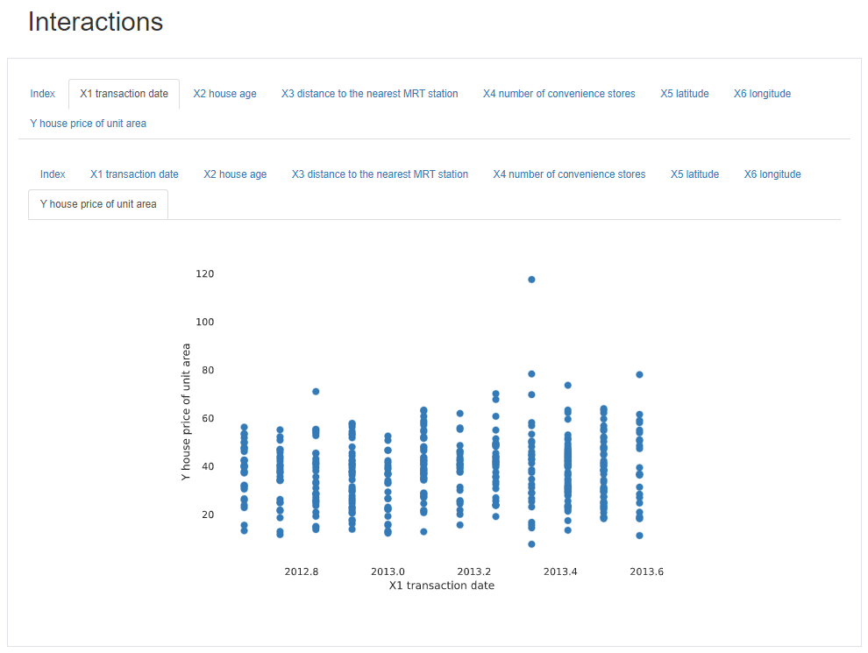

Slide 12

Sampling By Data Sampling, we can select, manipulate and analyze a representative subset of data points to identify patterns and trends in the larger dataset being examined. The dataset thus obtained is a weighted sample of the actual dataset, thus enabling a clear picture of the bigger dataset with minimal performance, retaining the overall data density and distribution.

Slide 13
Sampling
Function Call
Sampling(input_dataframe,task_type,input_appname)
Sampling techniques
Stratified Sampling/ Random Sampling/ Systematic Sampling
Sampling accuracy
Using a Null Hypothesis for each column, calculate the p-value using Kolmogorov-Smirnov test (For Continuous columns) and Pearson's Chi-square test (for categorical columns). If the p-values are >=0.05 for more than a threshold number of columns (50% used here), The subsample created is accepted.
Return best Sample
Return the best Sample data to pass into the next step i.e. AutoCleanser. The best sample is the one with highest p-value as it is a measure of statistical similarity between two datasets.

Slide 14
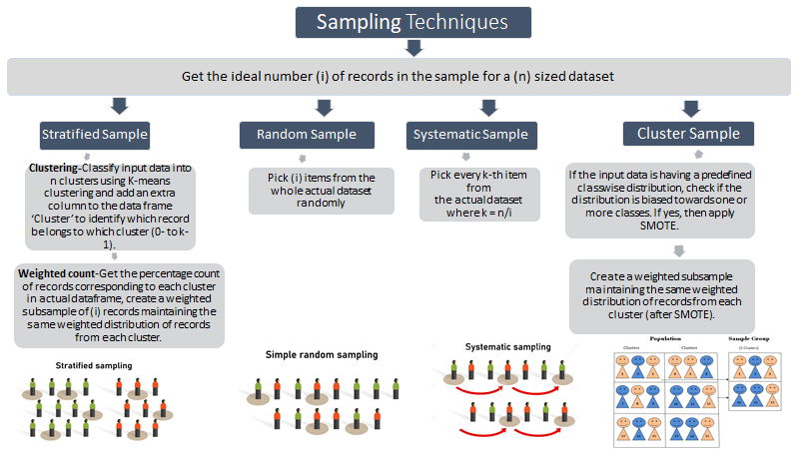

Slide 15
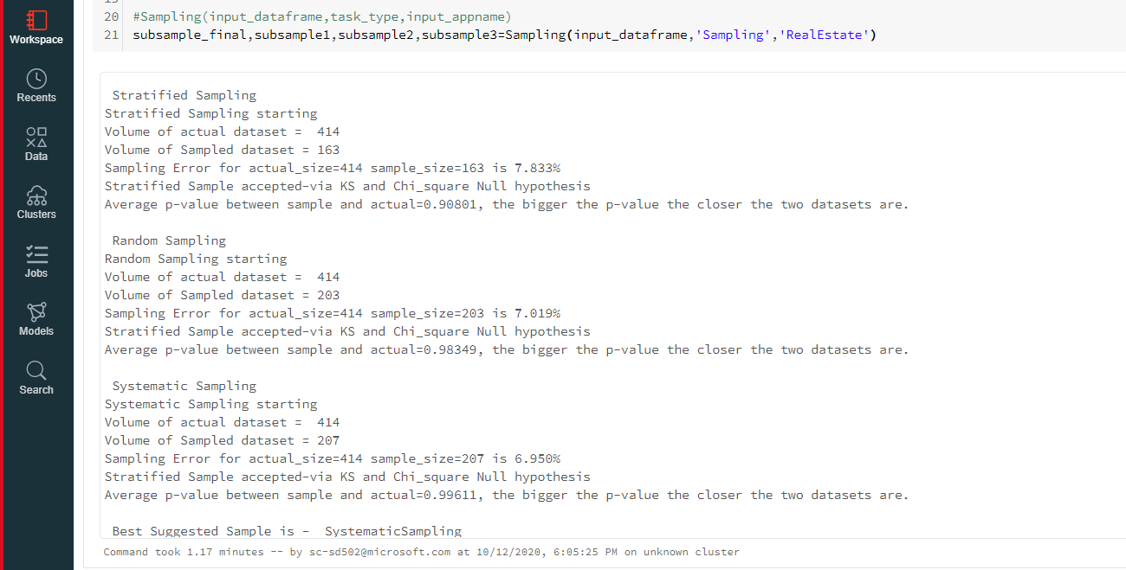

Slide 16

Data Cleansing Because it improves your data quality and in doing so, increases overall productivity. When you clean your data, all outdated or incorrect information is gone – leaving you with the highest quality information.

Slide 17
Data Cleansing
Function Call
autodatacleaner(subsample_final,task_type,input_appname)
Handle Missing Values
Impute/Drop missing columns based on threshold.
Imputation
Missing Data Imputation – Both Numerical and Categorical.
Fix Structural Errors
Fix inconsistent capitalization, leading/trailing white spaces for categorical columns.
Encoding
Label Encoding of Categorical Columns
Normalization
Scaling of data for normalization

Slide 18
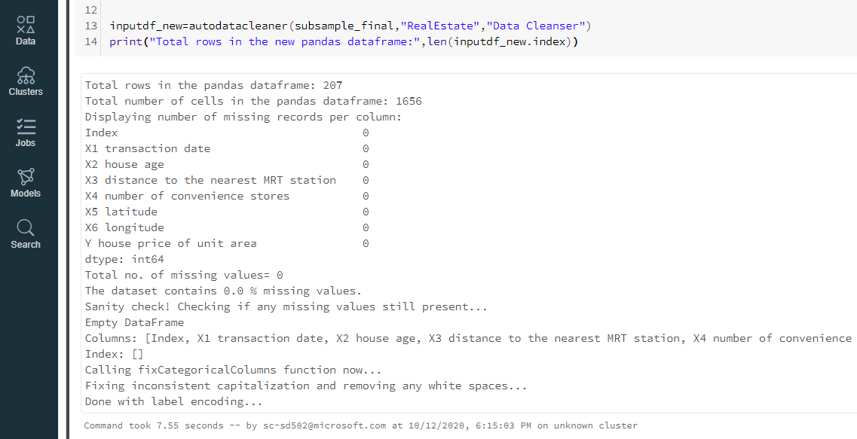

Slide 19


Anomaly Detection
Anomaly detection aims to detect abnormal patterns deviating from the rest of the data, called anomalies or outliers. Handling Outliers and anomalies is critical to the machine learning process.

Slide 20
Anomaly Detection
Function Call
AnomalyDetection(dataframe,target_variable, variables_to_analyze, outliers_fraction)
Apply
Algorithms
Apply different Anomaly Detection Algorithms(ABOD, CBLOF, HBOS, KNN, Feature Bagging, Isolation Forest, Average KNN)
Visualize Results
Visualize the Anomalies using all different Anomaly Detection Algorithms.
Remove Outliers
Download the Data feed with Outlier’s marked to remove from original dataset.

Slide 21
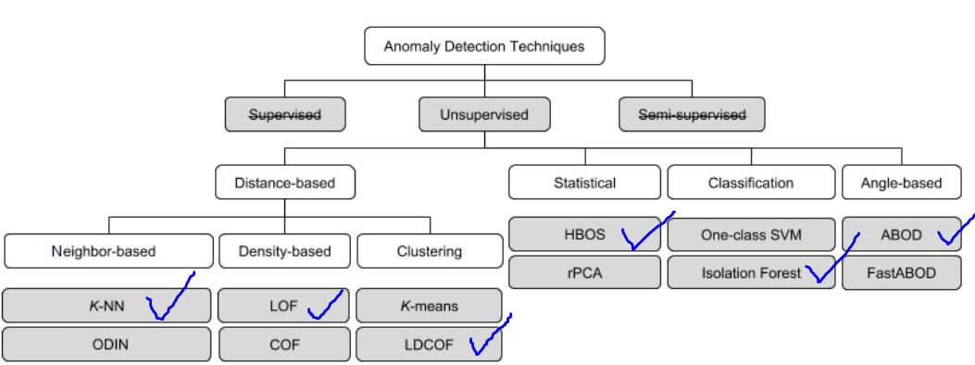
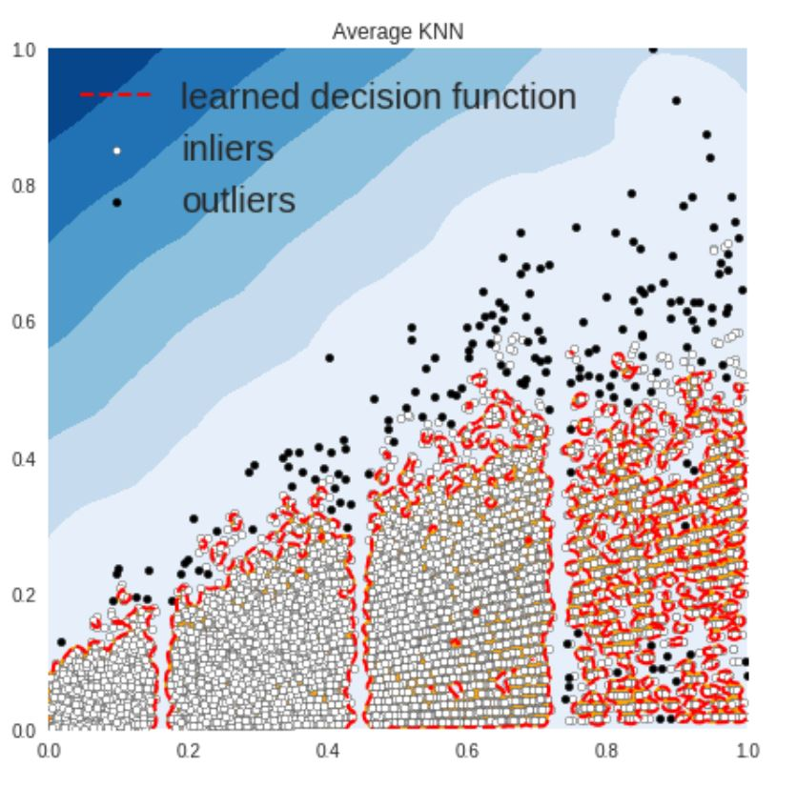
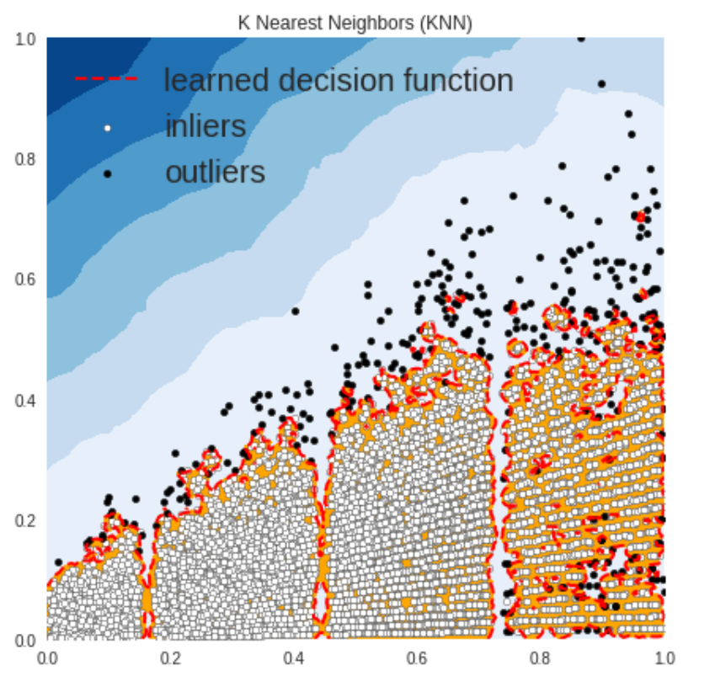
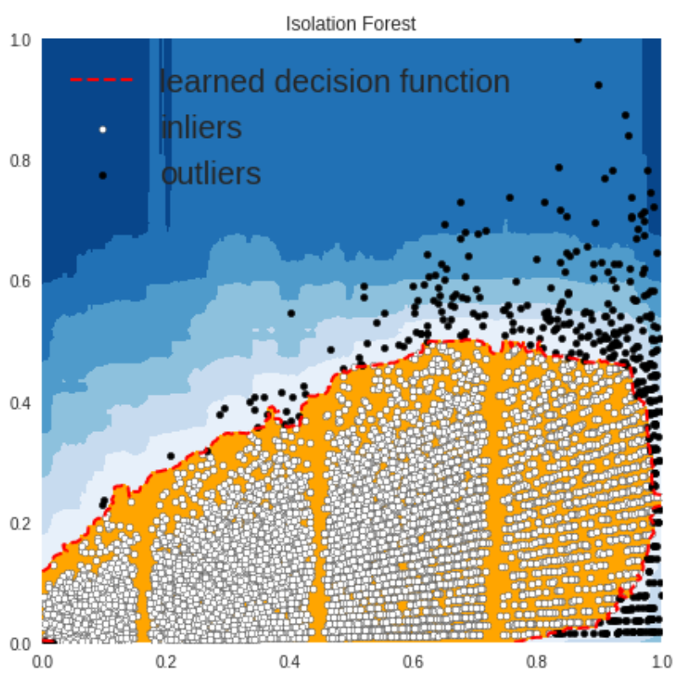
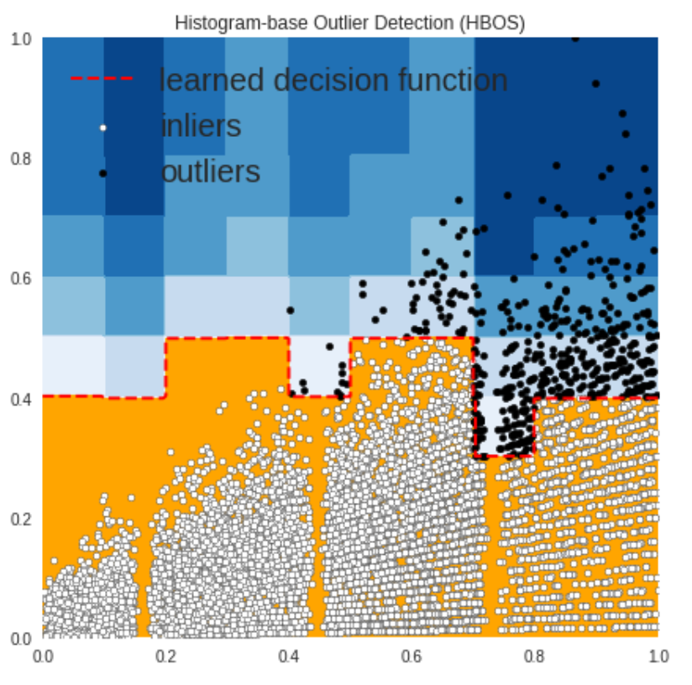
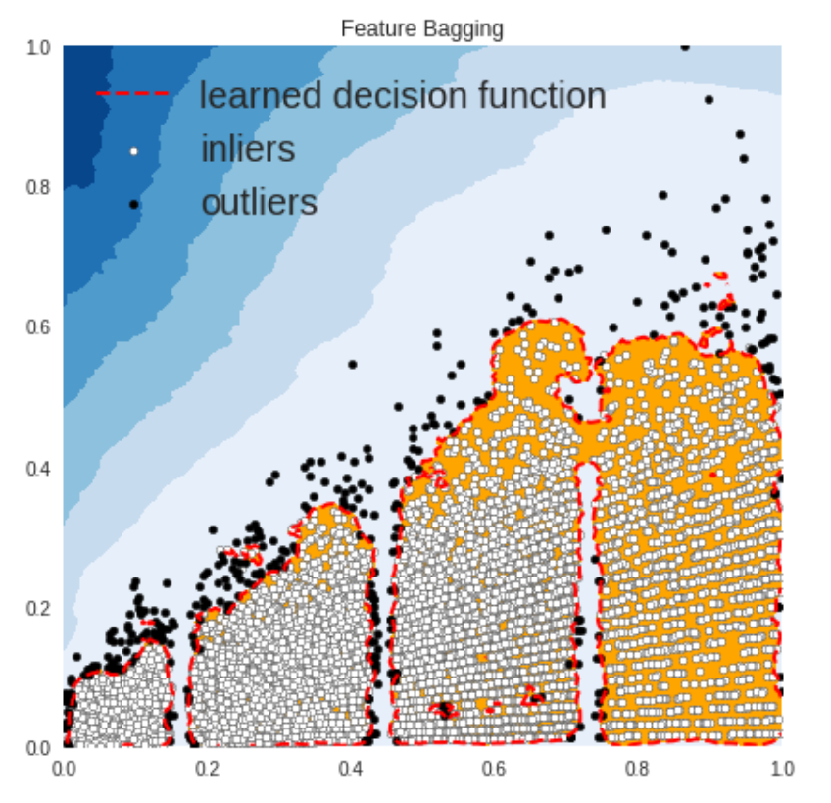
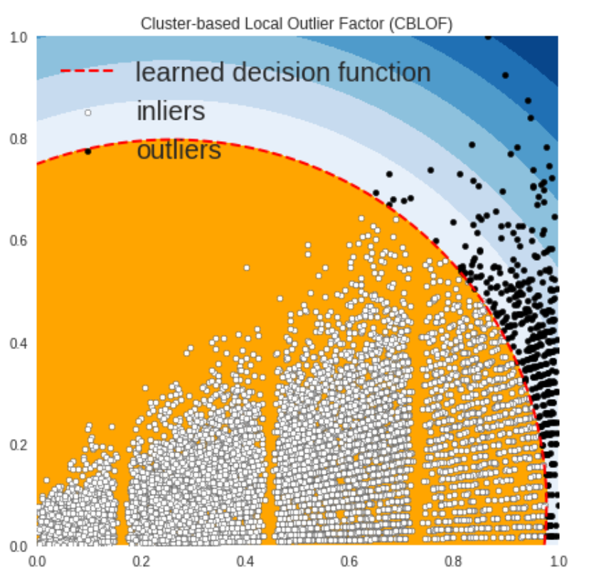
Anomaly Detection (Explained)

Slide 22
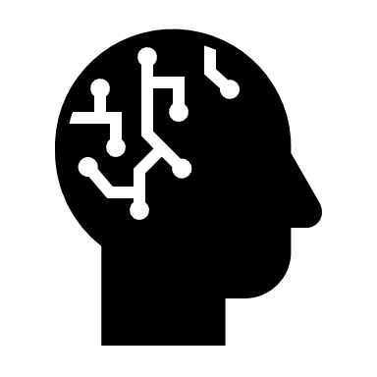
Azure Automated machine learning
Automatically build and train machine learning models with speed and scale

Slide 23
Auto ML Steps
Function Call
AutoMLFunc(subscription_id,resource_group,workspace_name,input_dataframe,label_col,task_type,input_appname)
Split Dataset
Split data to train and test.
Azure Auto ML Config
Set the automated ML configuration parameters depending on task type such as regression or classification.
Submit
Submit the experiment for AML run.
Extract the best model and calculate accuracy and other metrics.
Extract
Deploy
Deploy & Consume the best model obtained using REST API
Create/Re-use AML Compute
Create a new AML Compute Cluster.Next run onwards, re use the same.

Slide 24
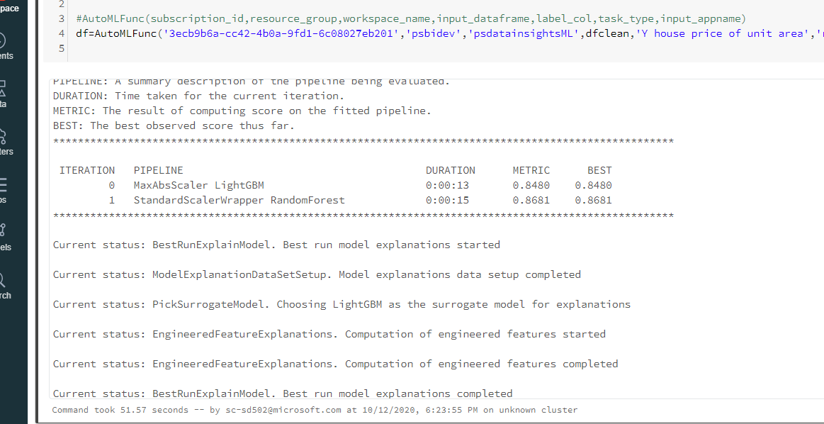

Slide 25
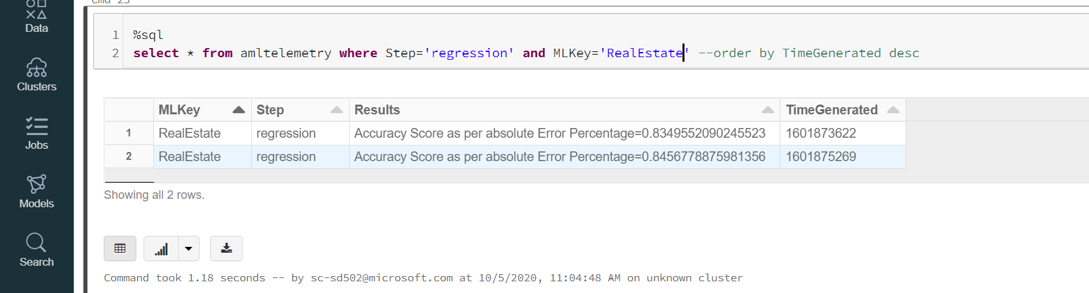

Slide 26
Benefits with Auto Tune ML for Landing Models in PROD
Easy to use framework in an automated manner and latch onto ML journey from scratch
Train and Retrain Data with new incoming data/trends. More control over data
Automated and Streamlined process with DevOps and ADF Integration
Reduced experimentation time drastically
Better accuracy than baseline models. Sampling, Cleansing etc capabilities helped raise the bar
Telemetry enables us to compare different versions of the same model/experiment
Framework is easy to use for newbies to build ML models

Slide 27


Responsible AI *In Pipeline going forward
AI systems can cause a variety of fairness-related harms, including harms involving people’s individual experiences with AI systems or the ways that AI systems represent the groups to which they belong. Prioritizing fairness in AI systems is a sociotechnical challenge.
Responsible AI Guidelines suggest the best way to build fairness, interpretability, privacy, and security into these systems.

Slide 28
Stages of a Pipeline with Responsible AI Guidelines
Identify Dataset Imbalances (Data Sampler)
Set prediction threshold (Optimizer)
1
2
3
4
5
Gather & Pre-process data
Build Model
Train & Evaluate Model
Deploy
Predict
Understand Model behaviour on real data (Error Analysis)
Prediction Analysis to users (Model Interpretability)
Predicting fairness for subgroups in Model (Fairlearn)
Available in Framework
In progress

Slide 29
Responsible AI Guidelines
Error Analysis
The process of examining set examples that your algorithm misclassified, so that we can understand the underlying causes of the errors. This can help us prioritize on which problem deserves attention and how much. It gives us a direction for handling the errors.
Fairlearn
To explain their models and understand the value and accuracy of their findings. Interpretability is also important to debug machine learning models and make informed decisions about how to improve them.
Model Interpretation and Exploration
SmartNoise
Assess and mitigate model unfairness. Avoid reinforcement of biases and stereotypes.
Differential privacy systems and practices that help keep the data of individuals safe and private.
Remove Biasness in data
Data bias in machine learning is a type of error in which certain elements of a dataset are more heavily weighted and/or represented than others. A biased dataset does not accurately represent a model's use case, resulting in skewed outcomes, low accuracy levels, and analytical errors.
Single threshold, demographic balance, equal opportunity, equal accuracy, subgroup thresholds.
Optimizer
Apply optimization strategy based on one of the above thresholds to change the predictions for model

Slide 30
Model Interpretation and Exploration
1
Feature Importance values- Global (Based on whole dataset, aggregated value) and Local(Record to record basis)
Model Summary
Azure ML Interpret and Exploration class
Insights & live commentary about the model summary like feature importance, Accuracy/Recall/Precision/Confusion Matrix etc scores.

Slide 31
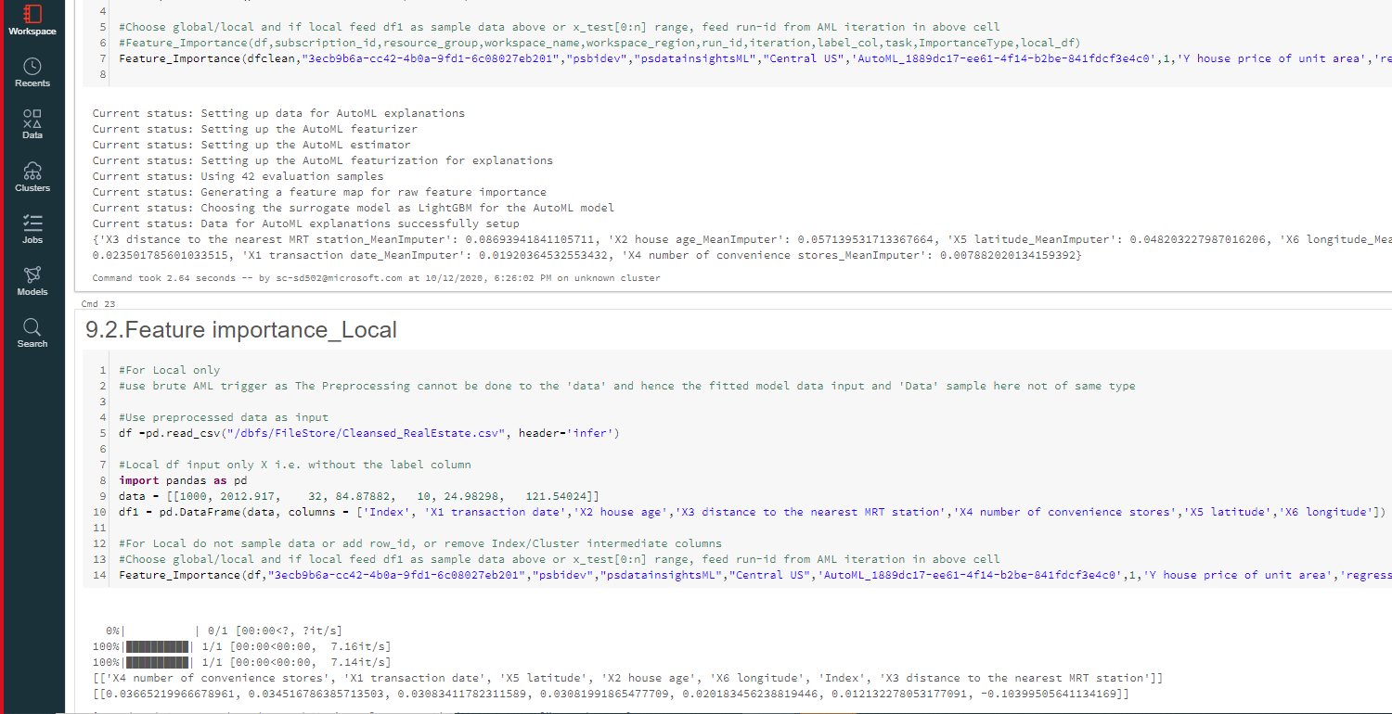

Slide 32
Error analysis
Prediction Inaccuracy
Confusion matrix to identify pattern, if any object/datapoint is misclassified into another class, in case of imbalance in data it is possible.
Feature
Data Augumentation - Increase the diversity of data available for training models, without actually collecting new data.
Check for Data leak- Too good to be true Model due to overfitting.
Check on simple predictions/ business rule already known predictions if they are going wrong.
Compare model with baseline model, is the baseline model classifying or giving better results?
Do we have all data?Is our data authentic?
Do we have any missing data? If yes cleanse it.
Have we done proper train/test split? Use 'Fairlearn' to estimate this.
Data
Avoid Fitting Validation/ Test data too with scaler or vectorizer/encoder. This also adds to Data leak as the 'To be predicted data' is already known to model.
Outlier Detection
Model Drift
If distribution of train data and test data is Statistically different this may cause bad predictions. Use NULL Hypothesis to check the statistical twinning of Test and Train Feature data.
Regression
Check R square for goodness of fit to model. An R square of 1.0 indicates that the data perfectly fit the regression model. Any value less than 1.0 indicates that at least some variability in the data cannot be accounted for by the model (e.g., an R2 of 0.5 indicates that 50% of the variability in the outcome data cannot be explained by the model).
2

Slide 33
Fairlearn
3
Assess Model Fairness
*Estimate group fairness- Which subgroup of a sensitive feature are likely to face risk of being ignored/sterotype.
*Quantify- Use Disparity metrics like Accuracy scores, Precision, Selection Rate (Fraction of datapoints in each class classified as 'True') by each class of the sensitive feature.
Mitigation Algorithm
*Reduction of Disparity by weighing the groups up or down by assigning them a weight inversely proportional to their frequency while modelling. *While Sampling use a baseline ML to determine the Fairness of the sample and allow users to trad-off between bvest sample and fair sample.
*Postprocessing the model take the existing classifier and sensitive features to transform the same model to enforce fairness constraints. Eg: 'ThresholdOptimizer' to equalize the odds between different groups of users of our model. *Data Augmentation to oversample the minority class of the sensitive feature.

Slide 34
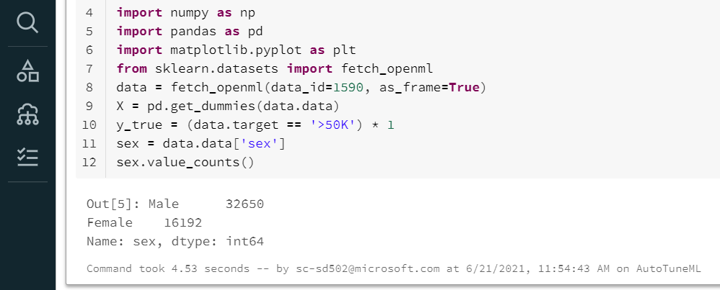
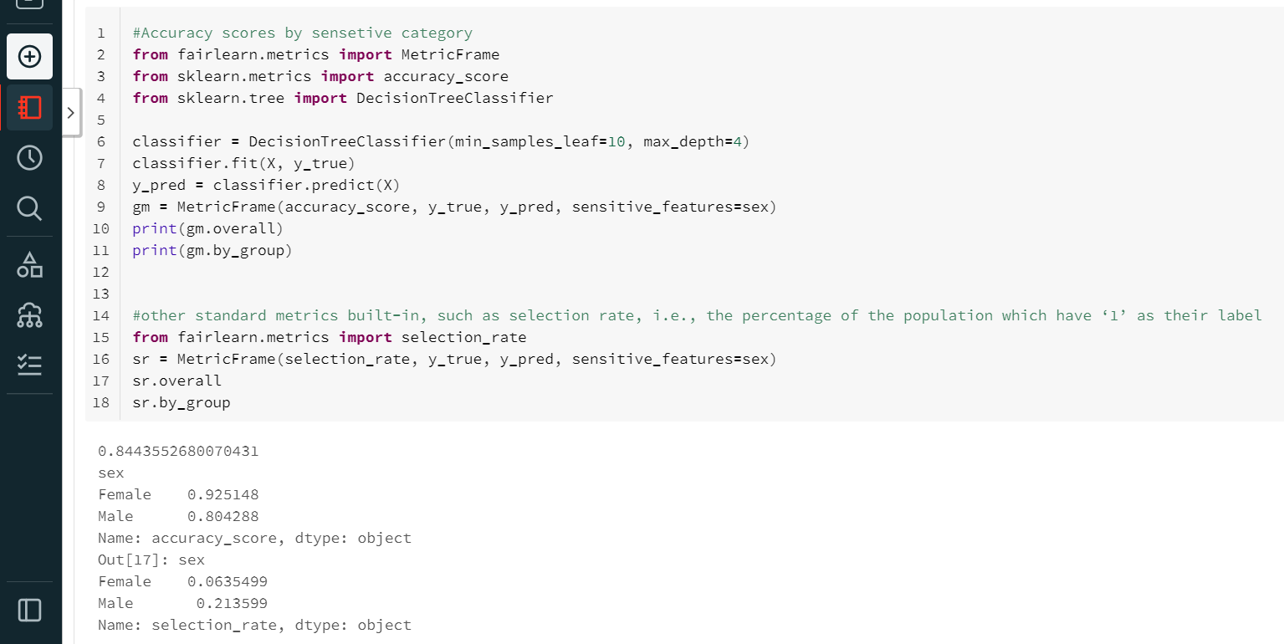

Slide 35
Remove Biasness in data
Sensitive Data Bias
Feature Columns are imbalanced and are skewed to create a bias towards a class or stereotype towards other classes.
Identify columns that have imbalance in distribution and are typical to model like col=sex/class/country etc. Get count of categories in biased columns of data with Counter(col). Oversample/Undersample on the basis of the sensitive feature col to remove biasness. Get count of categories in unbiased column now of data with Counter(col)
Majority Class Bias
Label column in case of Classification problem is biased and the probability of the outcome being the majority class is higher than that of the minority class.
Do not use absolute accuracy scores in such a case as it would always be very high and give wrong picture. Use F1 score instead
F1 score = 2*(Precision*Recall)/ (Precision + Rcall)
Oversample/Undersample based on the label col
Attach a weight to both the majority and minority classes of the label col inversely proportional to their frequencies. This will penalize the misclassification made by minority class by setting a higher weight while modelling and at the same time reducing weight for majority class.
4

Slide 36
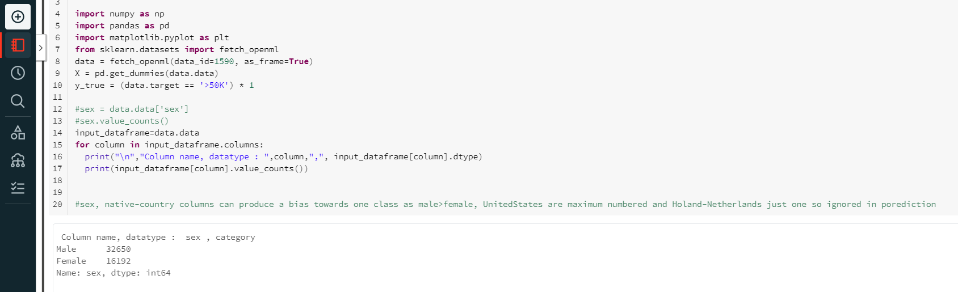
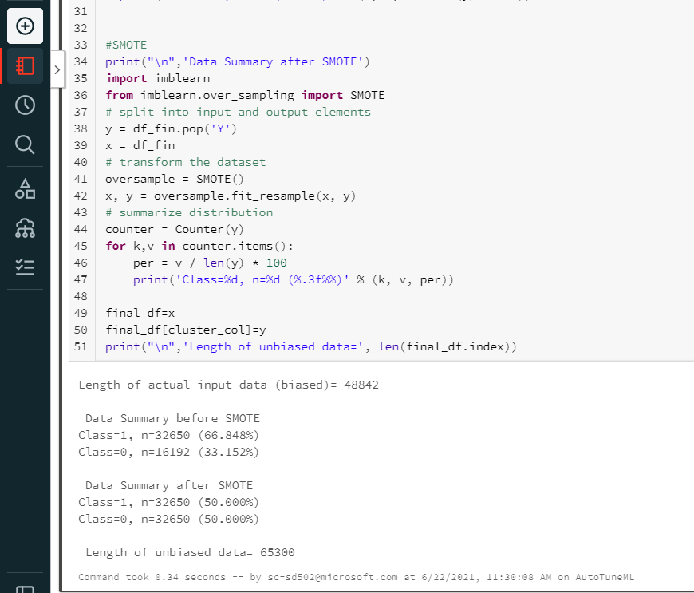
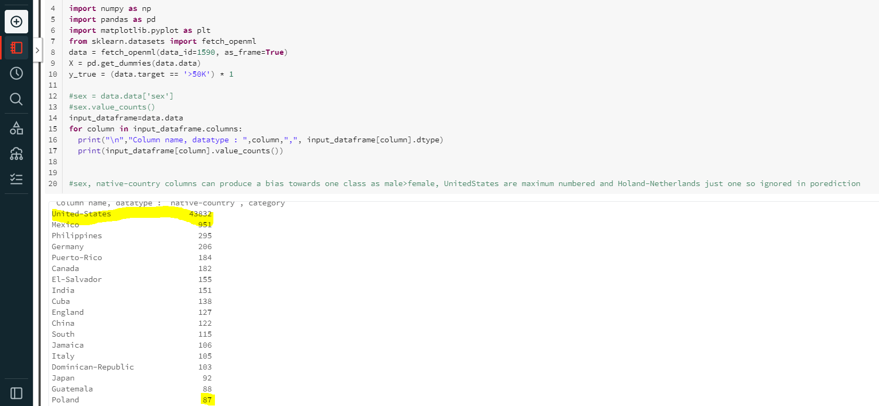

Slide 37
Q n A Session/ Feedback on Framework

Slide 38

Application of Auto Tune ML framework

Slide 39
PJMXP – Implementation of Auto Tune ML to Forecast Actual Hours

Slide 40
Problem Statement
To Forecast Actual Hours at a week grain based on the following inputs.
EngagementId
ProjectId
RequestID
DemandId
BPID
WeekStartDate

Slide 41
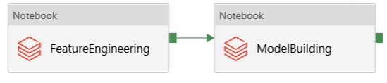
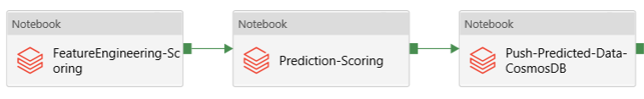
How the Jobs are set up?
AutoTuneML_Modelling_PJMXP Job (Frequency: Once a week)
AutoTuneML_Scoring_PJMXP Job(Frequency: Daily)

Slide 42
Modelling Job
AutoTuneML_Modelling_PJMXP Job (Frequency: Once a week)
Feature Engineering : PJMXP_FeatureEngineering.Py
Feature Engineering will read the raw files from lake and process them with features that will add value to the model.
Model Building: PJMXP_AutoTuneML_Modelling.py
This notebook will call the Sampling/Cleansing and other features of AutoTuneML to prepare the dataset.
It will then call the Azure AutoML to build the model and save it locally.

Slide 43
Scoring Job
AutoTuneML_Scoring_PJMXP Job(Frequency: Daily)
Feature Engineering-Scoring : PJMXP_FeatureEngineering_Scoring.py
This will prepare the scoring set equivalent to the modelling set
Prediction-Scoring: PJMXP_AutoTuneML_Scoring.py
This notebook will predict Actual Hours based on the trained model saved locally earlier.
Push-Predicted-Data-CosmosDB: PJMXP_AutoTuneML_CosmosDB.scala
This notebook will push the predicted data in the desired format to CosmosDB which will serve as a source for the API.

Slide 44
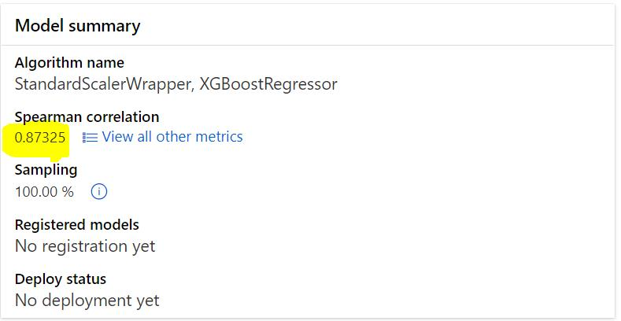
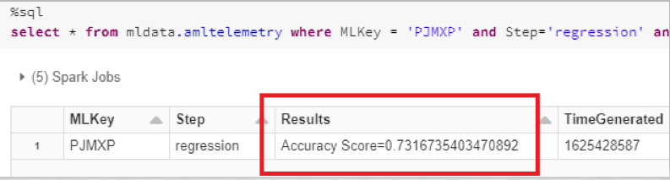
Model Accuracy

Slide 45
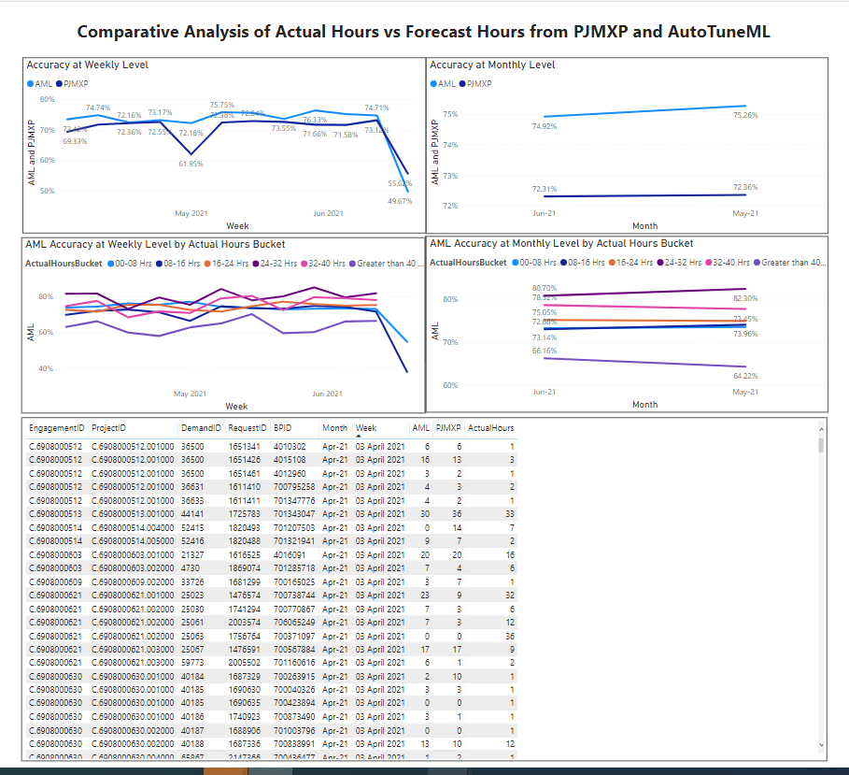
Current PJMXP Model vs Auto Tune ML for Actual Hours Prediction

